Slide 1



Jan 2025
Brillio’s Proposal on Customer 360 for Coty

Slide 2

Agenda
1
2
3
4
5
Our Understanding
Solution Approach
UX Design
Execution Approach
Team Structure & Commercials
Confidential / Brillio
2

Slide 3

Our Understanding
Our Understanding
Confidential / Brillio
3

Slide 4
Our Understanding of the Ask
We understand that Coty is looking for a solution for Customer 360 based on the requirements shared. Below is a summary of our understanding of the overall scope broken down by phases and the business processes. All assumptions and dependencies are outlined in later slides.
Phase 1 Scope
Next Phase Scope
Order Flow:
Efficiently manage and monitor the entire customer order flow in SAP, from creation to delivery and returns, including statuses, dates, quantities, weights, values, IDs, and invoices.
Integrate filters for locations, customers, products, and initiatives based on various dimensions.
Customer Health- Pricing:
Covers customer-level pricing conditions, trends, and simulations for better planning – Only Reports
Report price conditions for specific customers or hierarchies over selected time periods.
Customer Health- Scorecard:
Automate calculations for order-related KPIs: Orders & Order Lines Created, Orders per type, Order Changes, Invoices, Credit Notes, Rejected Lines, and Fill Rate.
Visualization of KPIs: Create dashboards for Local Markets with deep dives by Sales Organization, Customer, and Materials.
Cut Recovery:
Calculation of Potential Cuts: Compute potential order cuts based on inventory and receipts, covering details like Sales Org, Plant, Planning Customer Level, Product Code, and Product Category Hierarchy.
Visualization of Cuts: Display potential inventory cuts, identify shortage dates and products, and show affected sales orders and items.
Order Flow: End-to-end tracking of customer orders across TMS, WMS
Shipment Performance: Focus on identifying performance gaps and providing actionable insights for improvement
Forecast gap filling: Covers sales orders, product inventory, and receipt data at detailed levels (product, customer, etc.).
Initiative Management: Covers material-level and sales organization-level tracking of initiatives and promotional activities
Pricing Simulation: Covers customer-level pricing conditions, trends, and simulations for better planning.
Risk Management Alert Tracker: TMS Reports
Risk Management: Alert Tracker: Notifications - Covers stock levels, transportation issues, and customizable alert settings
Risk Management: MIR/LIR: Addresses inventory, orders, and forecasts to prevent potential disruptions (overall)
Dispute Monitoring: Covers claims and disputes at individual customer and customer hierarchy levels
Customer Service Reporting: Encompasses customer-level service data, order metrics, and service KPIs.

Slide 5
Our Understanding
Solution Approach
Confidential / Brillio
5

Slide 6







Customer 360 - Solution Tenets
Our solution is designed with the three core characteristics for the different personas to enable streamlined user experience, strong technical capabilities, and low operational overheads
To Deliver Business Outcomes-Phase 1
POWER BI APPROACH*
AGILE & FLEXIBLE IMPLEMENTATION
Implements star schema design principles with proper fact and dimension tables
Uses incremental refresh patterns to handle large datasets efficiently
Scalable and robust hybrid data modelling
Utilizes built-in AI features like Q&A and Smart Narratives
Future ready solution with latest features released by Microsoft
IMPROVED CUSTOMER EXPERIENCE
Improved CX through performance and design
Best in class UI/UX and design standards
Agile execution
Faster time to features
Improved backlog planning
Quicker feature onboarding/ offboarding
Personas Involved
Customer Support Executive
End Customers (no direct system access)
C-Suite/ Business Stakeholders
Sales Executive
(future)
* Power App will be part of future phases.

Slide 7
Possible Solution Options and Comparison
We have considered COTY’s requirements and the technology options, and below is our assessment and recommendation
Power Platform
ReactJS
Pros
Low-Code Platform:
Ideal for non-developers or those with minimal coding skills.
Drag-and-drop interface for building apps quickly.
Extensive templates and pre-built components
Integration with Microsoft Ecosystem:
Seamless integration with Microsoft services like SharePoint, Dynamics 365, Office 365, and Azure.
Rapid Development:
Speeds up the development of business applications for internal use.
Built-in Data Connectors:
Has multiple built in connectors to popular third-party and Microsoft services (e.g., Salesforce, SQL Server, etc.).
Cost:
No additional licenses required apart from standard PBI licenses (Coty have confirmed all users have E5 licences)
Ease of Support:
Existing Coty support team for Power Platforms, and user familiarity with UX
Cons
Restricted flexibility for complex or highly customized UI-solutions compared to ReactJS.
Data refresh rate will be near to real time (not exactly real time)
Pros
Flexibility and Customization:
A highly customizable open-source library for building dynamic web apps.
Reusable Components:
Encourages code reusability and modular architecture, speeding up development.
High Performance:
Efficient rendering using the virtual DOM makes ReactJS suitable for apps with complex UIs with no limitations on scale/magnitude of transaction
Vast Ecosystem:
Large community, extensive libraries, and tools to enhance functionality.
Independent from Ecosystems:
Works across any backend or third-party API, avoiding vendor lock-in.
Cons
Unlike PowerApps, it doesn’t come with built-in data connectors or business-ready components.
Requires skilled developers, which can increase costs.
Custom solutions take longer to develop compared to PowerApps' low-code approach.
Cost:
Additional infrastructure cost for deploying services needed
Recommendation
Based on Coty’s requirements and position that a high level of flexibility/customization will not be required, along with a need for a standardized support model, our recommendation is Power Platform as the solution of choice for this project. This proposal is based on a Power Platform solution

Slide 8





Customer 360 - Solution Overview
Already Completed Scope by Coty Team
Brillio Scope of Work
Consumption Layer
(Desktop only)
Power BI Solution – Phase 1
User Interface Designs
Integrations
Power BI Reports
Responsive Design
Power BI Integration with Databricks Unity Catalog
Power BI Integration
Data Layer
Lightweight Customer Data Platform
Source Data Replication to Raw Layer
Medallion Architecture
Semantic Data Layer (Customer 360 App)
To be provided by Coty Team
Raw, Cleansed and Curated Layer
Already available in Azure Databricks
Data Models for 4 areas in scope
Aggregated and Calculated Fields
Materialized Views
Consumption Layer
(Desktop only)
*
Overall - Power App Solution
User Interface Designs
Integrations
Data Store to Customer 360
Alerts/ Notifications*
Power BI Reports
Power App Screens
Responsive Design
Power BI Integration with Databricks Unity Catalog
Power App and Power BI Integration
Power App data inputs sync back to semantic layer (customer 360 app) through Dataverse, SharePoint, and power automate
Power Automate and Azure functions enabled email notifications
* Power App will be part of future phases.

Slide 9








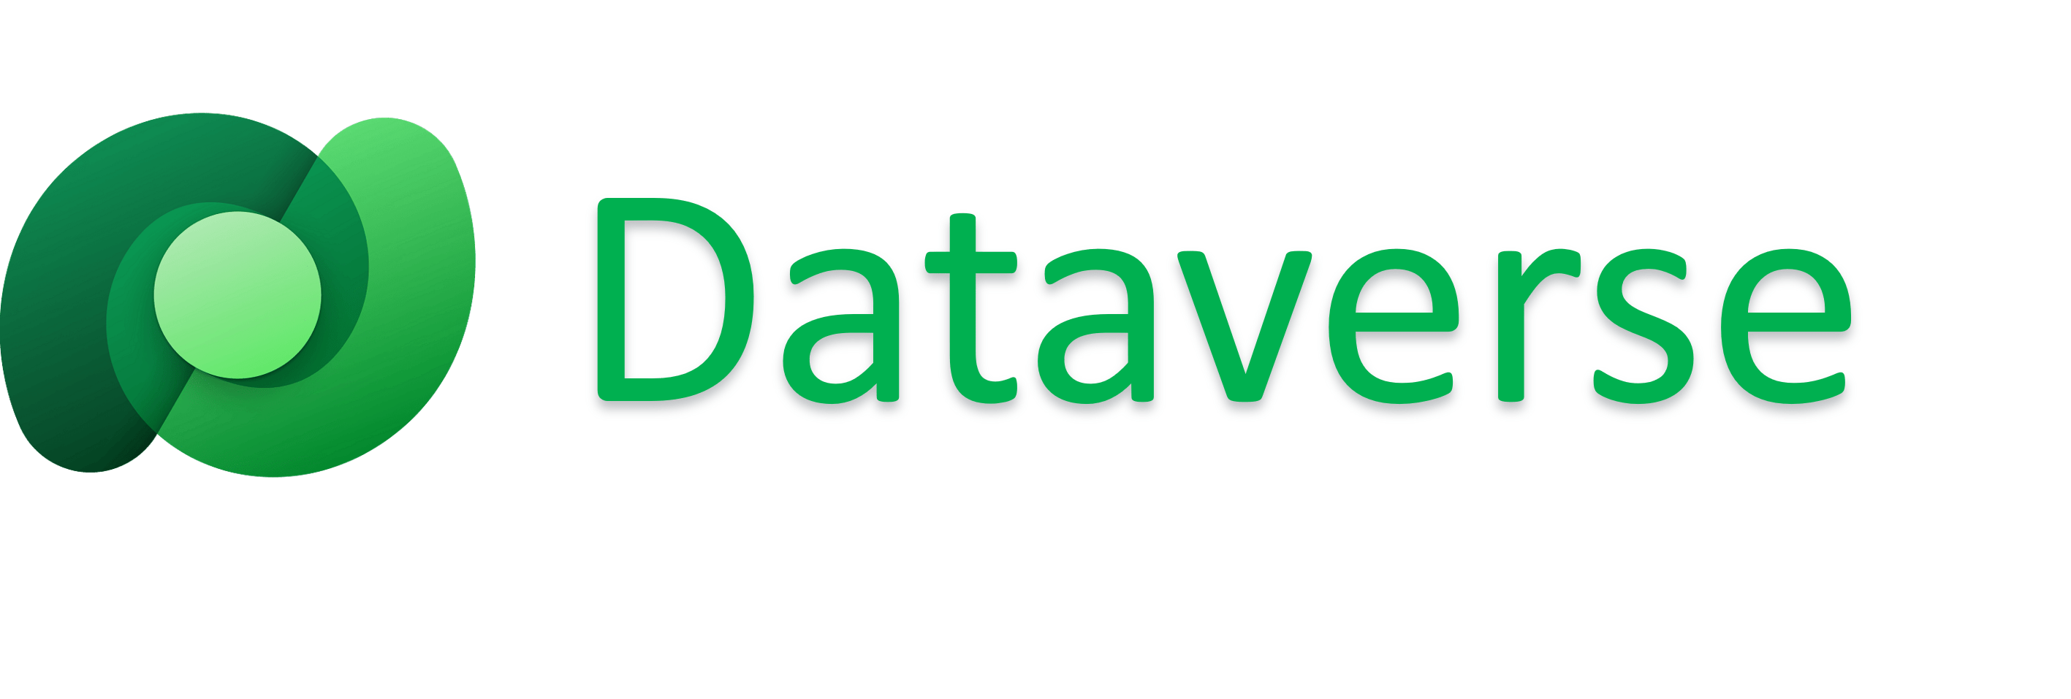



Customer 360 - Solution Architecture
Data Sources
Data Integration
Lightweight Customer Data Platform
Consumption
Semantic Data Layer
Phase 1
Phase 1
Phase 1
Visualizations, Screens and app for functionality
Aggregated Fields
Calculated Fields
Role based access controls
Alert and Notifications
Simulation Tool
Customer Order: Order Flow – SAP
Customer Health:
Pricing
Scorecard
Databases
Application Integration
SAP
SAP BW4
JDA/O9
Coty Data Cloud
SAP
SAP BW4
JDA/O9
Coty Data Cloud
Cut Recovery
Next Phase
WMS
Azure Notifications
Transportation (TMS)
High Radius
Blueplanner
Input Files
WMS
Databricks (calculations)
Azure Notifications
Transportation (TMS)
High Radius
Blueplanner
Input Files
Customer Order flow – TMS , WMS
Shipping performance & Forecast gap filling
Initiative and Promo Tracker - Initiative Management
Risk Management - Alert tracker & MIR/LIS
6. Customer Health
Dispute Monitor
Pricing Simulation
Service
Data Feeds/ Files
ETL/ ELT Tools
CLEANSED, DQ VALIDATED, NORMALIZED, ENRICHED
Data Quality, Validation, Logging, Monitoring & Alerts
Process automations, Email notifications
Custom connectors
Store data in CSV file
Bronze (Raw)
Silver (Cleansed)
Analytics and Reporting Tables
Enterprise Message Bus
Cloud Integration Services
Already Exists
Already Exists
Gold (Curated)
Already Exists
Data Governance | Data Security | Data Catalog | Data Lineage | Data Quality & Validation | Logging, Monitoring & Alerts | DevOps | DataOps
Note: This is the overall Solution Architecture. Brillio scope includes creation of semantic data layer, and consumption layer. The data governance, quality, monitoring etc. will be in scope only for semantic data layer and consumption layer. Other upstream and downstream components will be fully functional and available to Brillio team at start of the engagement. We will reuse
Brillio Scope of Work

Slide 10
Customer 360 - Solution Focus Areas- Phase 1
Solution Area
Focus Area
Our Approach
Semantic Layer
Map data schemas for different modules
Handling the table joins complexity
Target data model and KPIs
Design data model to address majority of reporting needs
To develop a composite model for all 4 dashboards
Reusable Data Discovery Databricks Notebooks for data and metadata profiling
Leverage source to target mapping to create data dictionaries
PySpark based Data Transformations
Ensuring the transformations are accurate through Brillio data validation framework
Query optimization with processing pushed down to Databricks and hence compute will be planned accordingly
Data for semantic layer can be fetched from any of raw, silver, and gold layer
Consumption Layer
Power BI integration with Databricks Unity Catalog with right refresh rate
Incremental refresh once a day in Power BI data model will be enabled with inbuilt Power BI connector with Databricks Unity catalog
Performing the integration and UAT testing to ascertain right functionality, performance, refresh rate, and latency
Power BI will be run as app in the Power BI service to provide access to end user
Authentication and authorization through Microsoft Entra ID
Note: Existing data lake is built with medallion architecture
Notes:
Existing data lake is built on medallion architecture. Existing data can be from raw, curated, and gold layer
Query pushdown to databricks for processing
Compute will be planned accordingly
Data discovery notebooks – data and metadata profiling with unity catalog- accelerator

Slide 11













Data Modeling for Semantic Data Layer
Data Analysis & Workshop
Agile based Iterative Delivery
Consumption
Quantitative analysis
Prioritization
Product Backlog
Assign keys
Qualitative analysis
Apply data model patterns
Sprint Planning
Business Validation
Identify relationships
Normalize to reduce data redundancy
Sessions with business and IT stakeholders to understand the KPIs and modeling requirements
Finalize the target fields in semantic data layer along with required operations like aggregations, complex calculations, etc.
Source to Target mapping
Sprint Backlog
Apply naming conventions
Reusable Data Discovery Framework
DQ Framework
~20% effort savings

Slide 12




Data Transformation from Existing Data Lake to Semantic Layer
Brillio will design the data transformation capabilities by using applicable Databricks features like Autoloader, Notebooks and Delta Live tables.
Semantic Layer Data Transformations
ORCHESTRATION
Databricks workflows will be used to orchestrate the data pipelines
Delta Live will be used to build the data processing pipelines and set the configurations to manage the business rules required for transformations
Autoloader combined with Databricks transformation notebooks in the pipeline will load the new files and write them onto Semantic layer delta tables (if required)
Semantic layer data model will be enabled using either delta tables or materialized views as applicable
DQ framework will be built with “Great Expectations framework” for data quality, validation, monitoring, logging, and alerts
Data Standardization , Transformations, pipeline orchestrations
STORAGE
Existing Data Lake
Semantic Layer
DQ Framework

Slide 13

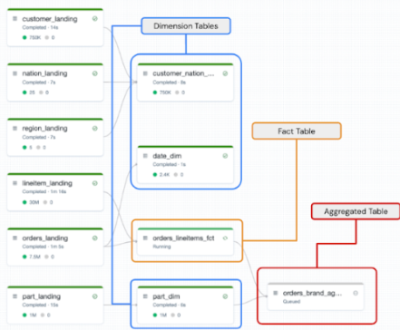
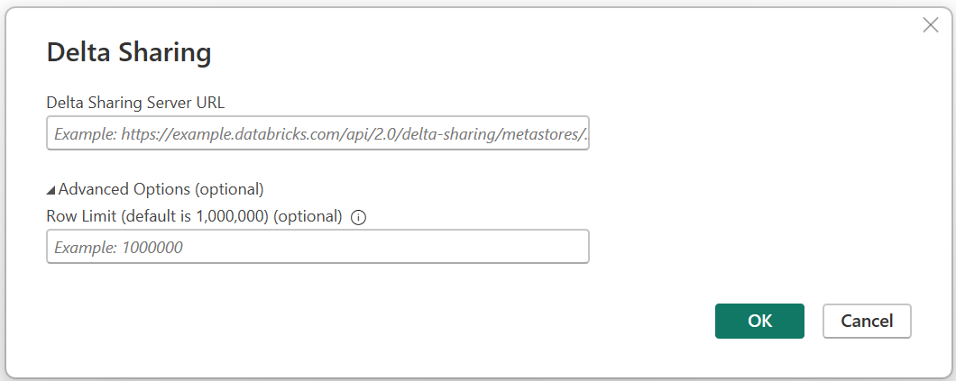
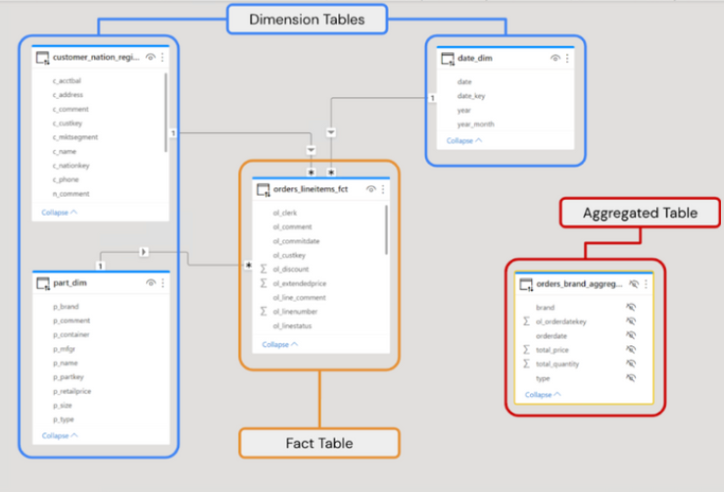
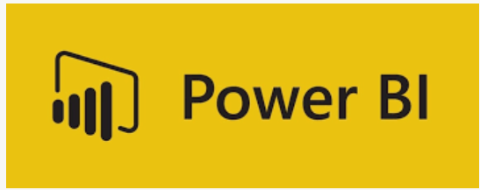
Consumption - Power BI Connection with Databricks Unity Catalog
Databricks Data Catalog
Data Governance
Power BI Report Model
Using Delta Live Tables offers the following benefits:
Declarative pipeline development, improved data reliability, and cloud-scale production operations. Users can perform both batch and streaming operations on the same table and the data is immediately available for querying.
Support for streaming to provide fresh and up-to-date data by only processing new data
Have confidence in your data with built-in data quality testing and monitoring
Automatically generated lineage graph between all tables
Automated management and auto-scaling of the clusters to run the pipeline

Slide 14
Performance of Power BI
Data Set Size Limit
Power BI Pro has a 1 GB per dataset limit when using Import mode.
Performance issues can arise if the dataset approaches this limit due to heavy aggregations, relationships, or inefficient modeling.
Record Count
There is no hard limit on the number of records Power BI can handle, but the following guidelines apply: Power BI can comfortably handle millions of rows of data in Import mode, provided the data model is optimized (e.g., by removing unused columns, reducing cardinality, and avoiding heavy calculated columns).
For DirectQuery mode, the record count depends on the performance of the underlying data source. Querying very large tables (e.g., hundreds of millions of rows) might lead to performance degradation if the database is slow or poorly indexed.
Performance Factors
Performance issues usually arise not from the record count itself, but from
High Cardinality: Columns with many unique values (like IDs or timestamps) can slow down performance due to large dictionary sizes.
Complex Relationships: Too many relationships or circular dependencies can impact query performance.
Visual Complexity: A large number of visuals on a single page can increase rendering time.

Slide 15







Global Media Dataset for Coty
Before State: Performance Issue due to
A model was developed for each report.
Transformations were handled in Power BI report.
Star Schema was not followed and unwanted data import.
After State: Performance Improvement highlights
Reduced model size by 80% with common data model.
Reduced cost by 60% with reduction in refresh time for all reports i.e., <15 minutes
Reports development is made easier by handling specific data on project requirements
Data Source
Semantic Layer
DataFlow
Semantic Layer
Media Data Quality Tracker
Model size: >400 MB
Refresh Time: >3.5 hrs
Media Data Quality Tracker
Global Media Model
Size: <200 MB
Refresh Time: <15 mins
Meta / Snapchat / TikTok Reports
Model size: >300 MB
Refresh Time: >1.5 hrs
Meta / Snapchat / TikTok Reports
Media E&E Model (Composite)
Size: ~30 MB
Refresh Time: <5 mins
Media E&E Program Tracker
Media E&E Program Tracker
Model size: >500 MB
Refresh Time: >3.5 hrs

Slide 16
Meta / Snapchat / TikTok Reports
Media Data Quality Tracker
Media E&E Program Tracker

Slide 17
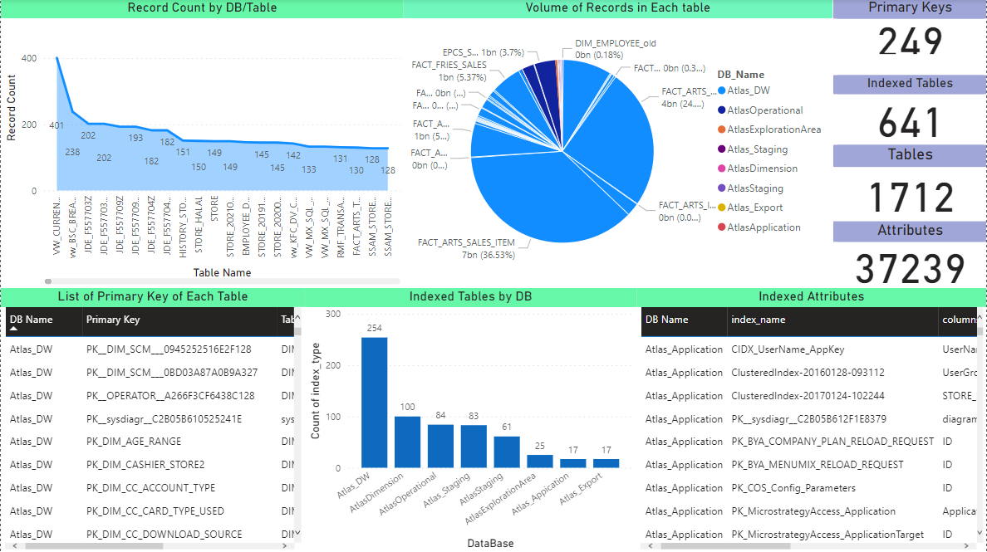
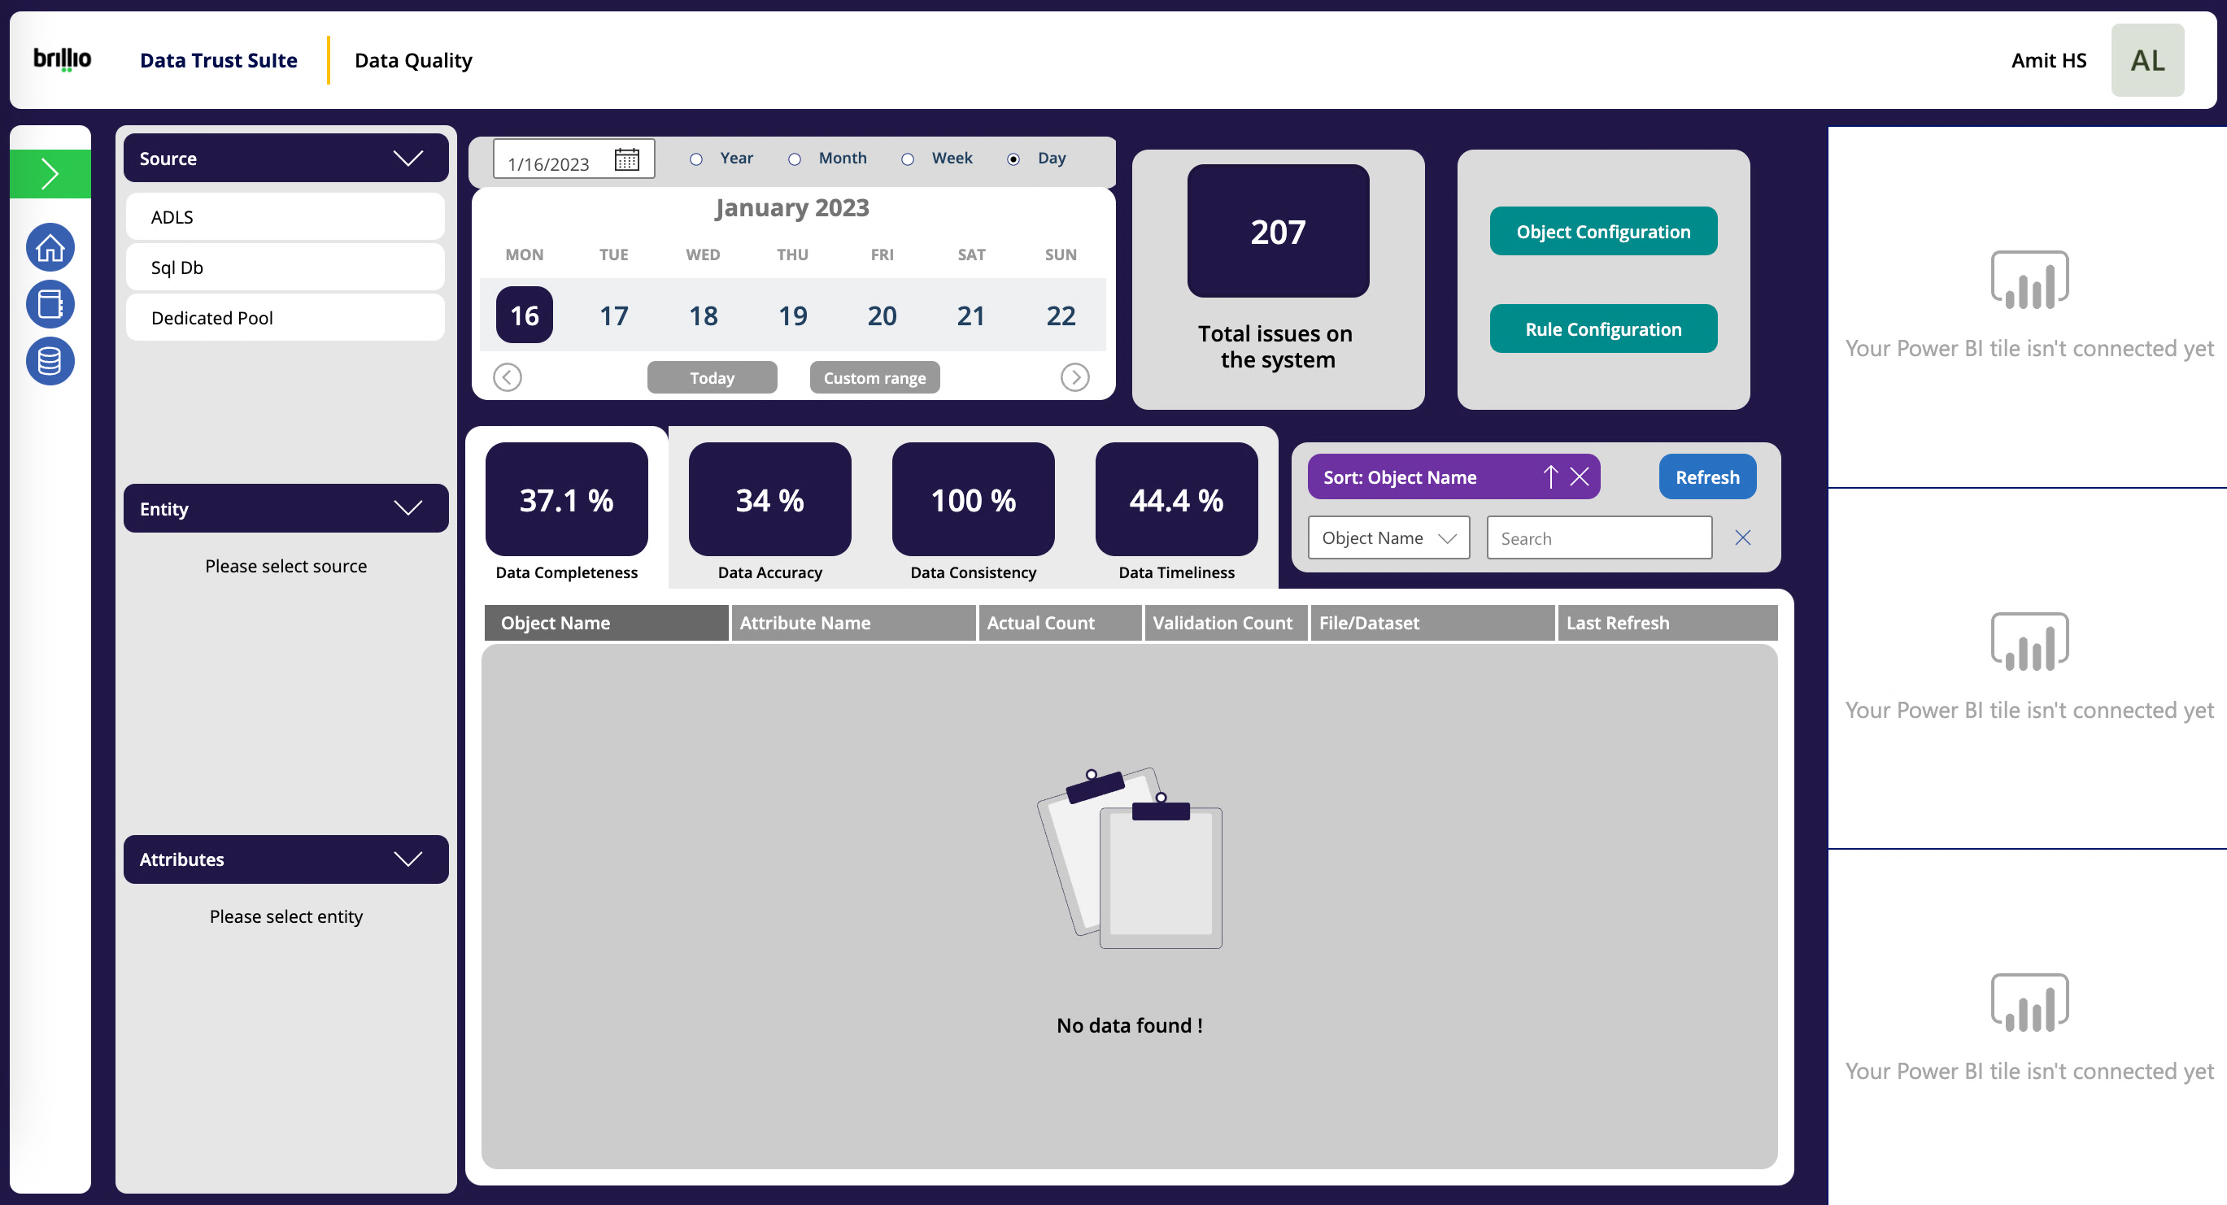
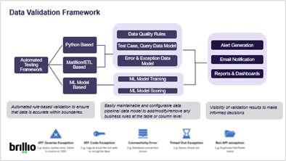
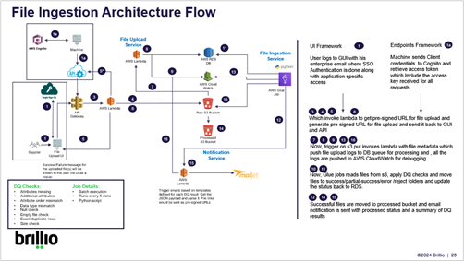





Brillio Key Frameworks / Accelerators
Data Discovery Framework
Data Quality Framework
Data Validation Framework
File Ingestion Framework
Data profiling of different data domains to find object metadata & ensure enriched data operations
Common DQ framework for data validation, quality and enrichment
Python based testing framework that automatically connects to source and target database and validates the data across different layers
PySpark framework to extract file information and ensure correctness of the information through ML based DQ checks
Identifies data objects/ elements, user access, query relationship, expensive query, and inefficient query performance in the current landscape.
Detecting anomalies of current ETL jobs, data movements, etc.,
Automatic corrective action suggestions based on SOPs created across Data Management/ Analytics/ Marketing & sales tracks
Rule based validation approach has been implemented and error logs and audit table entries are made automatically
ML based DQ checks for file processing and ascertaining the right information through python-based code
~20% effort savings during implementation
The accelerators that will be used during the engagement. File ingestion framework may be useful and repurposed once the requirements are more detailed.

Slide 18
Our nderstandin
SAP capabilities
Confidential / Brillio
18

Slide 19

Brillio - SAP Partnership
Brillio is an SAP silver partner with 20+ project experience and our SAP Center of Excellence enables us to strategize, implement complex SAP cross-platform solutions, development of multi-tenant, SaaS based Data Custodian portal that will be deployed on Public Cloud Platform.
Capabilities
S4 HANA Private & Public Cloud, BTP, SAP Commerce Cloud
Managing SAP workloads on Multi Cloud Environment
Assessment & evaluation of Commerce solutions
Provisioning of infrastructure and Cloud Tailored Services to SAP customers
Fully Managed Services for Solution running on HANA, Cloud, Commerce platforms & solutions
Implementations
Migration and Modernization of SAP on Cloud: Brillio leads businesses in migrating and modernizing SAP systems on cloud environments, helping to improve operational efficiency and reduce TCO
Implementation of SAP BTP, Commerce Cloud and Marketing Cloud to create robust, scalable environments.
SAP CoE
Innovative Solutions, Accelerators, Frameworks: Brillio’s SAP Center of Excellence (CoE) develops innovative accelerators, frameworks, and reusable components to streamline SAP implementations and reduce time-to-market.
Reusable Components: Our SAP CoE offers reusable components to improve development speed and ensure quality across projects

Slide 20











Brillio-SAP Capabilities Overview
50+
20+
10+
Cloud Transformation
SAP talent
Certified associates
Key Clients
Service Authorization
Rise with SAP
Migrating SAP systems to cloud environments, leveraging multi-cloud strategies and cloud-native services
Enabler of Rise with SAP, focusing on transforming enterprises through brownfield, greenfield, and Bluefield approaches
S/4Hana
SAP Technologies
Business Technology
CX Management
Enablement of brownfield and greenfield implementations for SAP S/4HANA migrations
Integration of S/4HANA with other systems -SAP BTP
Optimization of financial operations through SAP S/4HANA Finance & Development, Workflows & Reports
SAP Cloud ALM, Solution Manager: Manage entire lifecycle of applications
SAP GRC: manage risk, audit, and compliance
SAP Basis & HANA Administration: administration of SAP landscapes
SAP Security: Integrate security measures and GRC integration
Integration services using SAP BTP to connect with external applications and third-party solutions
Custom extensions and applications using SAP BTP
Integrating intelligent technologies like AI/ML, RPA into business processes
Advanced data analytics solutions integrating SAC
SAP Commerce Cloud: Deliver personalized shopping experiences across digital channels.
SAP Fiori: Enhancing user experience
Cloud Lifecycle Management
AMS Services
Brillio leverages SAP Cloud ALM to manage the entire lifecycle of SAP applications.
Support and maintenance of SAP systems, including 24/7 support for SAP Applications

Slide 21




Transforming with SAP Functional Modules Manufacturing, Supply Chain, and Financials
Manufacturing Excellence
Supply Chain Optimization
Financial Agility
Integrated Intelligence
Production Planning (SAP PP): Streamline production schedules and reduce lead times.
Quality Management (SAP QM): Enhance product quality and compliance with industry standards.
Plant Maintenance (SAP PM): Improve equipment uptime and maintenance efficiency.
Materials Management (SAP MM): Optimize inventory levels and procurement processes.
Sales and Distribution (SAP SD): Streamline order processing and fulfillment.
Extended Warehouse Management (SAP EWM): Enhance warehouse operations and efficiency.
Financial Accounting (SAP FI): Streamline financial operations and reporting.
Controlling (SAP CO): Enhance cost management and profitability analysis.
Treasury and Risk Management (SAP TRM): Optimize cash flow and financial risk management.
SAP HANA: Leverage in-memory computing for real-time analytics and insights.
SAP Business Intelligence (BI): Enable data-driven decision-making and performance monitoring.

Slide 22
Our Understanding
User Experience
Confidential / Brillio
22

Slide 23
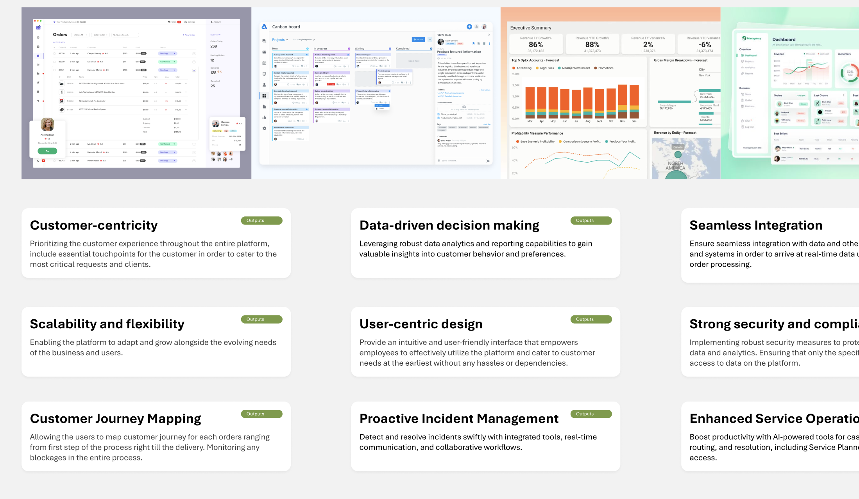
Step 1: Building Coty's Customer 360: Key Tenets
Designing Customer 360 Interface
To deliver the best user-centric Customer 360 solution, we conducted thorough research into existing customer relationship platforms (CRPs). This analysis focused on identifying key functionalities and features essential for a successful implementation.
Customer 360°: Gain a holistic view of customers with comprehensive profiles, segmentation, and personalized recommendations.
SEE FULL RESEARCH
Notes:
Enhanced Service Operations: Boost productivity with AI-powered tools for case management, routing, and resolution, including Service Planner and knowledge base access.
Proactive Incident Management: Detect and resolve incidents swiftly with integrated tools, real-time communication, and collaborative workflows.
Customer Journey Mapping: Optimize customer experiences and drive business growth by visualizing interactions and identifying areas for improvement across the entire customer lifecycle.

Slide 24
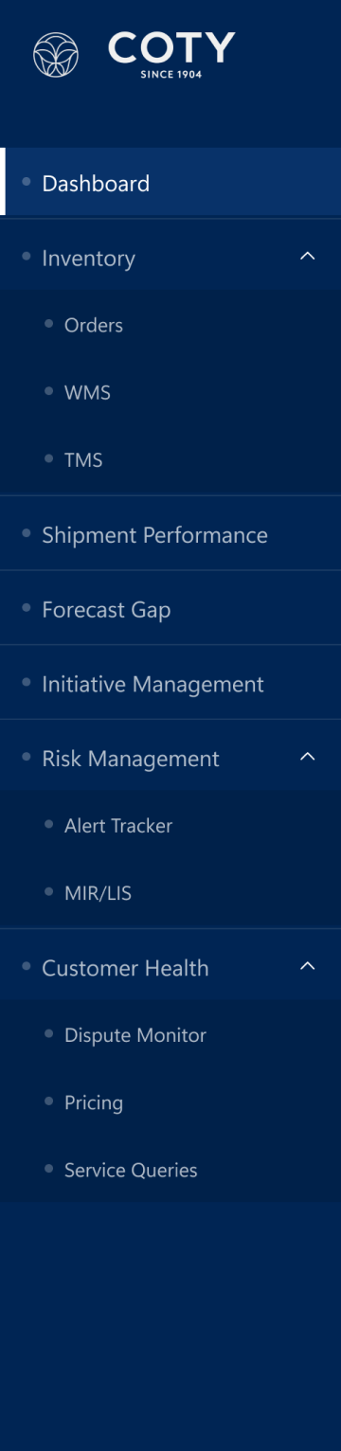
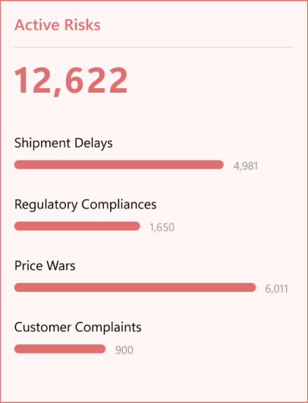
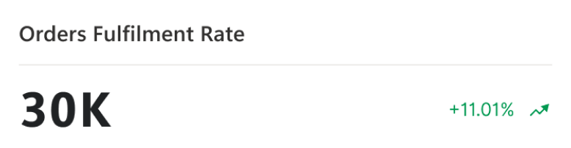
Step 2: Creating an Intuitive Customer 360 Interface
Designing Customer 360 Interface
The second step involved determining the specific elements to be included on each screen. This decision was based on thorough research, existing requirements, and careful consideration of user needs for orders, dashboards, and other critical screens.
Dashboard Elements
Key Performance Indicators (KPIs):
On-Time Delivery Rate: Percentage of orders delivered within the agreed-upon timeframe.
Order Fulfillment Rate: Percentage of orders successfully fulfilled.
Customer Satisfaction Score: Aggregate customer satisfaction ratings.
Forecast Accuracy: Measure of how accurately sales forecasts align with actual sales.
Open Disputes: Number of active customer disputes.
Side Global Navigation
Customer Orders
System and Applications Product (Main one)
Warehouse Management System
Transportation Management System
Shipment Performance
Forecast Gap
Initiative Management
Risk Management
SEE FULL RESEARCH

Slide 25
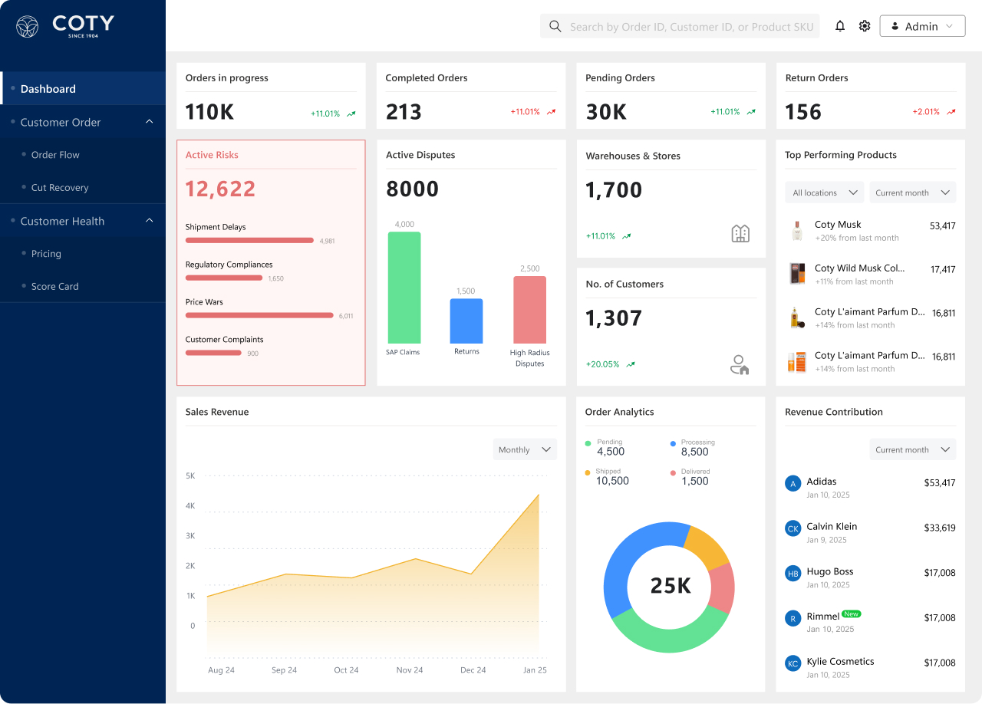
Dashboard Representation – Art of the possible #1
Dashboard Experience achieved:
Key Performance Indicators (KPIs):
On-Time Delivery Rate: Percentage of orders delivered within the agreed-upon timeframe.
Information Hierarchy and Visual Clarity: The dashboard employs a clear visual hierarchy, grouping to guide the user's eye to the most critical information first. This reduces cognitive load and allows users to quickly grasp key insights.
Intuitive Navigation and Interaction: Navigation is designed to be intuitive and user-friendly.
Data Visualization and Interpretation: The dashboard utilizes effective data visualization techniques to present complex data in a digestible format.
Clear, targeted and goal-oriented CTA
Dashboard

Slide 26
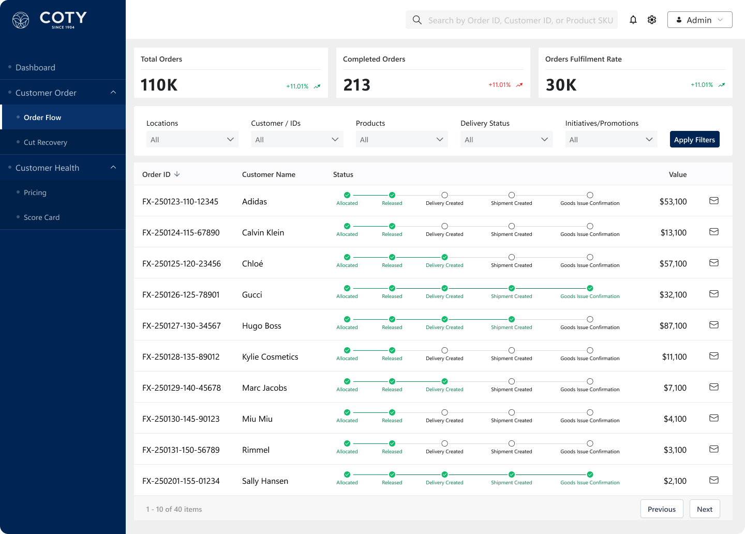
Dashboard Representation – Art of the possible #2

Slide 27
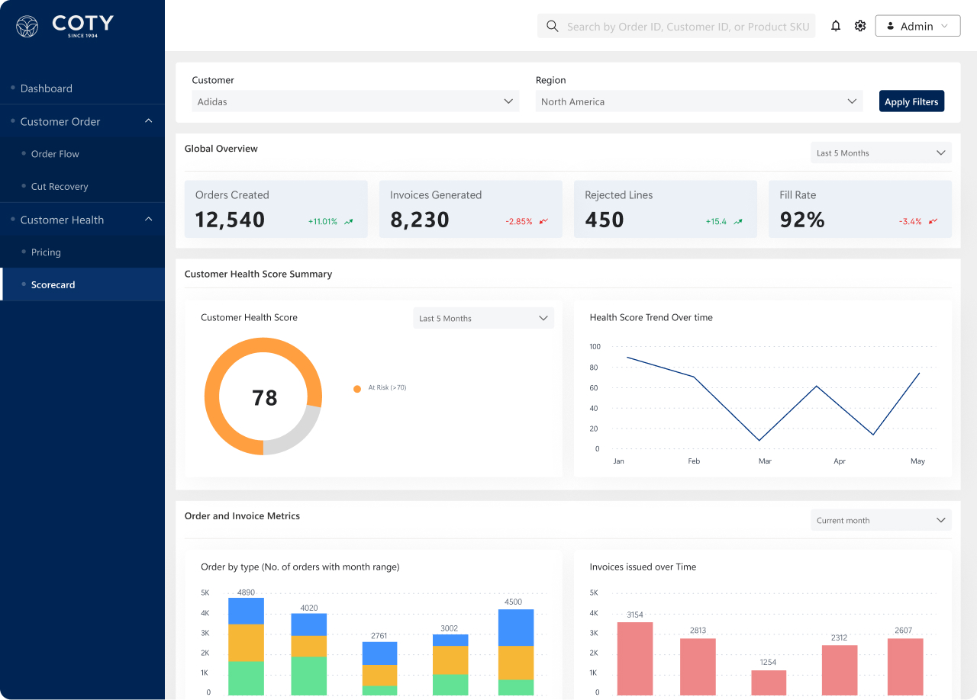
Dashboard Representation – Art of the possible #3

Slide 28
Our Understanding
Execution Approach
Confidential / Brillio
28

Slide 29
Execution Approach – Agile Implementation
PHASE 1
NEXT PHASE
Data profiling and modeling for ~80 tables through data discovery framework
Implement pilot for testing existing functionality with excel dashboards for 20-30 customers
Implement the semantic data layer, Power BI
Perform UAT and Production support for the implemented use cases
Last sprint - Tech Debt
Data profiling and modeling for ~380 tables remaining
Implement pilot for testing existing functionality with excel dashboards for 20-30 customers
Implement the semantic data layer, power bi, power app solution
Perform UAT and Production support for the implemented use cases
Last sprint - Tech Debt
OUTCOMES
OUTCOMES
Power BI Application for following:
Customer Order Flow - WMS, TMS
Customer Order Shipment Performance - SAP, JDA/O9
Customer Order Forecast Gap Filling – SAP, JDA/O9, Databricks (calculations)
Customer Health Dispute Monitor – SAP, High Radius
Risk Management Alert Tracker – SAP, TMS, Azure (notifications)
Risk Management MIR/ LIS – SAP, JDA/O9
Initiative and Promo tracker – Blueplanner, Input tool
Customer Service Reporting – SAP BW4, Highradius
Pricing Simulation – SAP, Databricks (calculations)
Power BI Application for following:
Customer Order Flow-SAP
Customer Health Pricing- SAP
Cut Recovery – SAP, JDA/O9
Customer Health Scorecard- SAP , BW4

Slide 30



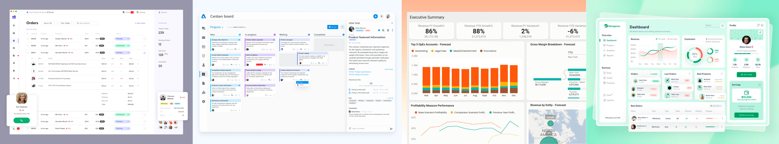
Overall Execution Timeline
Sprints
Sprint 1
S2
S3
S4
S5
S6
S7
S8
S9 Onwards
March
April
May
June
July onwards
Phase 1
Next Phases
Discovery & Design
(First ~80 tables)
Pilot
(Schema and Metrics validation)
Build and Deploy
Customer Order Flow – Ability to Navigate from Order to Delivery, Integrate Filters
Customer Health Pricing - Ability to report for specific customer(s) or durations
Scorecard – Automated Calculation for KPIs
Cut Recovery – To Calculate Potential Cuts & Visualize
Code Promotion + Hypercare 2 Weeks

Slide 31
Proposed Team Structure for Coty
Brillio Team
Oversight role: Delivery Manager
Coty Team
Common (Shared) Roles
Project Manager
Business Analyst
Business Leadership
Technical Leadership
Front-end team
Power BI Architect
Power BI Developers
Design Leads
UX Designers
Product Owners/PMs
Data team
Data Architect
Data Engineers
Data Test Engineer
Program Managers

Slide 32

Governance Model
Coty
Brillio
Deliverables
Coty Leadership
Monthly/
Bimonthly
Client Partner
Delivery Partner
Program Health
Delivery Roadmap
Value Engineering
Priorities Alignment
Innovation & Transformation
Engagement Relationship, Health of Program, Escalated Issues, Strategic Planning
Product Owner
Business SME
Program Manager
Weekly
Delivery Partner
BA, Lead
Delivery Commitment Review
Escalation Handling
Issue & Risk Management
Program Level Planning, Dependency and Prioritization – POD health, Risk / Issues
Product Owner / SPoC
Daily
Project Team
Customer Satisfaction
SLA Review
Quality Assurance
Service Management
Resource Management
Track day-to-day Progress & Impediments, Quality metrics and KPIs
Operations – Day-to-day operations, Quality, CSAT, SLA-based performance management
The engagement reporting will be sent to Coty stakeholders through CODEX
Senior management at Brillio monitor project status on this platform and provide remedial action in-case there is any slippage.
Customer Pulse Platform

Slide 33
Dependencies
Assumptions for Phase 1
Customer order flow – SAP is considered in Phase 1 . Customer order flow TMS and WMS are considered for Phase 2.
Coty team will provide qualified source data required to build Customer 360 on Data Lake (Databricks) with bronze (raw), silver (cleansed), and gold (curated) layer already in place.
Coty will grant access to its Power BI platform
Coty team manages DevOps to deployment code to higher environments from Development Environment.
Phase 1 scope contains transformation of total of ~80 tables in scope from gold layer to semantic layer , ~ 5 semantic data models at presentation layer ; Power BI - 2 data model builds , 50 metrics calculation . Phase 2 & 3 combined consists of total of ~380 tables transformation. All tables are assumed to contain up to 40 columns on average.
Total 4 Power BI screens with 2 data model, 50 metrics calculation and 15 charts/ graph/ visuals are considered for development based on requirement analyzed at high level
Currency and currency conversion data received from SAP/ raw/ silver/ gold layers will be considered the source of truth and used as is for reporting purposes.
Data quality and validation (including flat files) is considered only in the operations performed to transform and load data in semantic layer. The original data received by Brillio team is considered source of truth.

Slide 34
Dependencies
Dependencies
All users to possess M365 E5 with Power BI Pro licenses for working with the dashboard.
Coty will share prior findings / research / inferences / code / use cases / design documents / features – architecture and design already explored before the start of the engagement – if available.
Coty stakeholders perform reviews and provide approvals (architecture, data model, UI/UX, technology stack), within reasonable time.
Coty to provide all necessary brand guidelines and digital design guidelines.
Coty business owners to identify the key stakeholders for clarifying requirements, reviewing all deliverables, participate in UAT and grant sign-off on deliverables.
Coty to onboard the team and provide access for the development purpose

Slide 35
Our Understanding
Success Stories
Confidential / Brillio
35

Slide 36








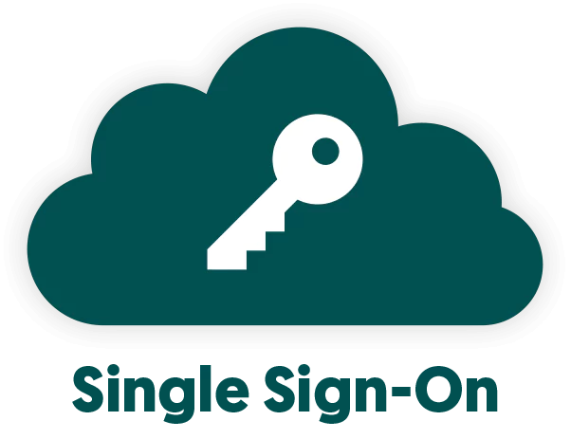






McDonald’s File Ingestion Architecture Flow
1a
File Upload Service
Endpoints Framework
Machine sends Client credentials to Cognito and retrieve access token which Include the access key received for all requests
UI Framework
User logs to GUI with his enterprise email where SSO Authentication is done along with application specific access
1a
Machine
8
11
File Ingestion Service
1
1a
AWS Lambda
AWS RDS DB
5*
9
13
7
AWS Cloud Watch
AWS Glue Job
3
4
10
1
AWS Lambda
6
3
4
5
6
API Gateway
Raw S3 Bucket
Which invoke lambda to get pre-signed URL for file upload and generate pre-signed URL for file upload and send it back to GUI and API
12
14
1
5
16
Processed S3 Bucket
7
8
9
13
16
Now, trigger on s3 put invokes lambda with file metadata which push file upload logs to DB queue for processing and , all the logs are pushed to AWS CloudWatch for debugging
Supplier
File Upload UI
Notification Service
Success/Failure message for the uploaded file(s) will be shown to the user via UI as a popup
15
10
11
AWS Lambda
Now, Glue jobs reads files from s3, apply DQ checks and move files to success/partial-success/error /reject folders and update the status back to RDS.
DQ Checks:
Attributes missing
Additional attributes
Attribute order mismatch
Data type mismatch
Null check
Empty file check
Exact duplicate rows
Size check
Job Details:
Batch execution
Runs every 5 mins
Python script
Trigger emails based on templates defined for each DQ result. Get the JSON payload and parse it. File links would be sent as pre-signed URLs
12
14
15
Successful files are moved to processed bucket and email notification is sent with processed status and a summary of DQ results

Slide 37
Success
Detailed Success Stories
Confidential / Brillio
37

Slide 38

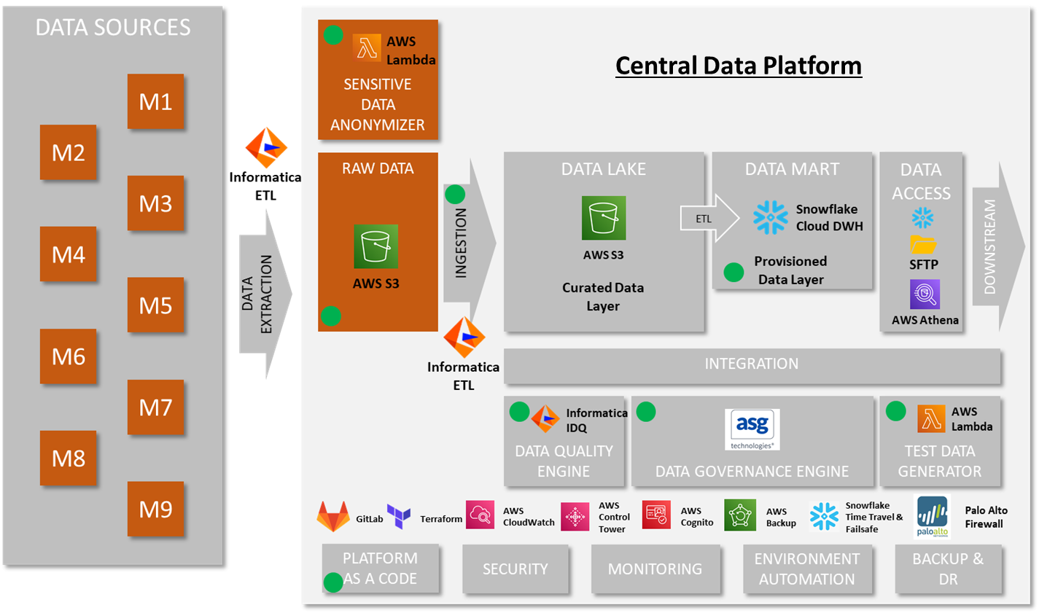
Solution Architecture to Enable CDP
Salient features
One stop for Global Data
Consolidated and Integrated
Standardized Data Definitions
Self Service and Data Democratization
As a Service Model and a Marketplace for sharing data
Repeatable and Reusable
Cost Efficiency and Automated Optimization
Secure by Design

Slide 39





Solution Approach
MODERN ANALYTICS PLATFORM
COMMUNICATION & COLLABORATION
COMPREHENSIVE VISIBILITY
Build single data source (DW) for SC360 to enable data science & reliable insights
Predict outcomes for key business areas
Prescribe actions for business process optimization
Deep dive to identify hidden trends
Enable collaboration through task assignment & response request
Seamless historical activity tracking
Real time notification & messaging capabilities
E2E view of Supply Chain performance
Top-down hierarchical view for management tracking
Complete order, deal, and planning view
Accurate reporting of revenue numbers
Lack of single source
of truth for reliable
decision making
Inconsistent business intelligence due to non standardized reporting
Inefficient and irregular
communication, collaboration &
vendor management
Lack of tooling for Self-Service MI/BI and Decision Science Predictive Analytics capability
Challenges
IMPACT DELIVERED
24% reduction in the overall cost
Near zero downtime enabling seamless network performance
Real time notifications and alerts to defined business rules

Slide 40

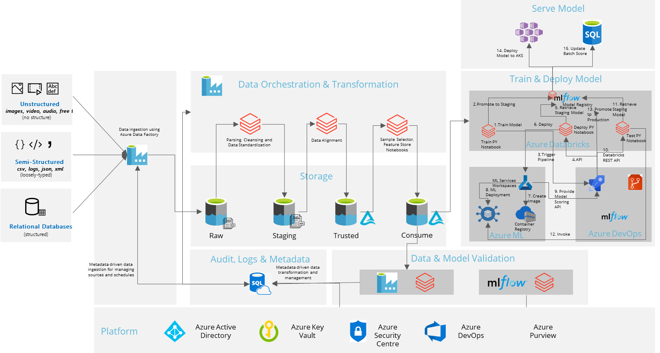
Greenfield Data Lake and Data Lakehouse
OVERVIEW
Azure data lake and delta lakehouse served as the central data repository, serving both the product and user needs. The primary products served were data models for reporting and feature stores used for data science model builds and consumption. Additionally, the data Lakehouse was used to build reports and data science models.
KEY FEATURES OF AZURE CLOUD DATA LAKE PLATFORM
Leverages native managed cloud components including Azure Data Lake, Azure Data Factory, Azure Databricks, and Azure DevOps services among others
The solution ensures Client developers, data scientists, and analysts to store data of any size, shape, and speed and do all types of processing and analytics across platforms
It removes the complexities of ingesting and storing multi-variety data while making it faster to get up and running with batch, streaming, and interactive analytics
Notes:
Lowell

Slide 41

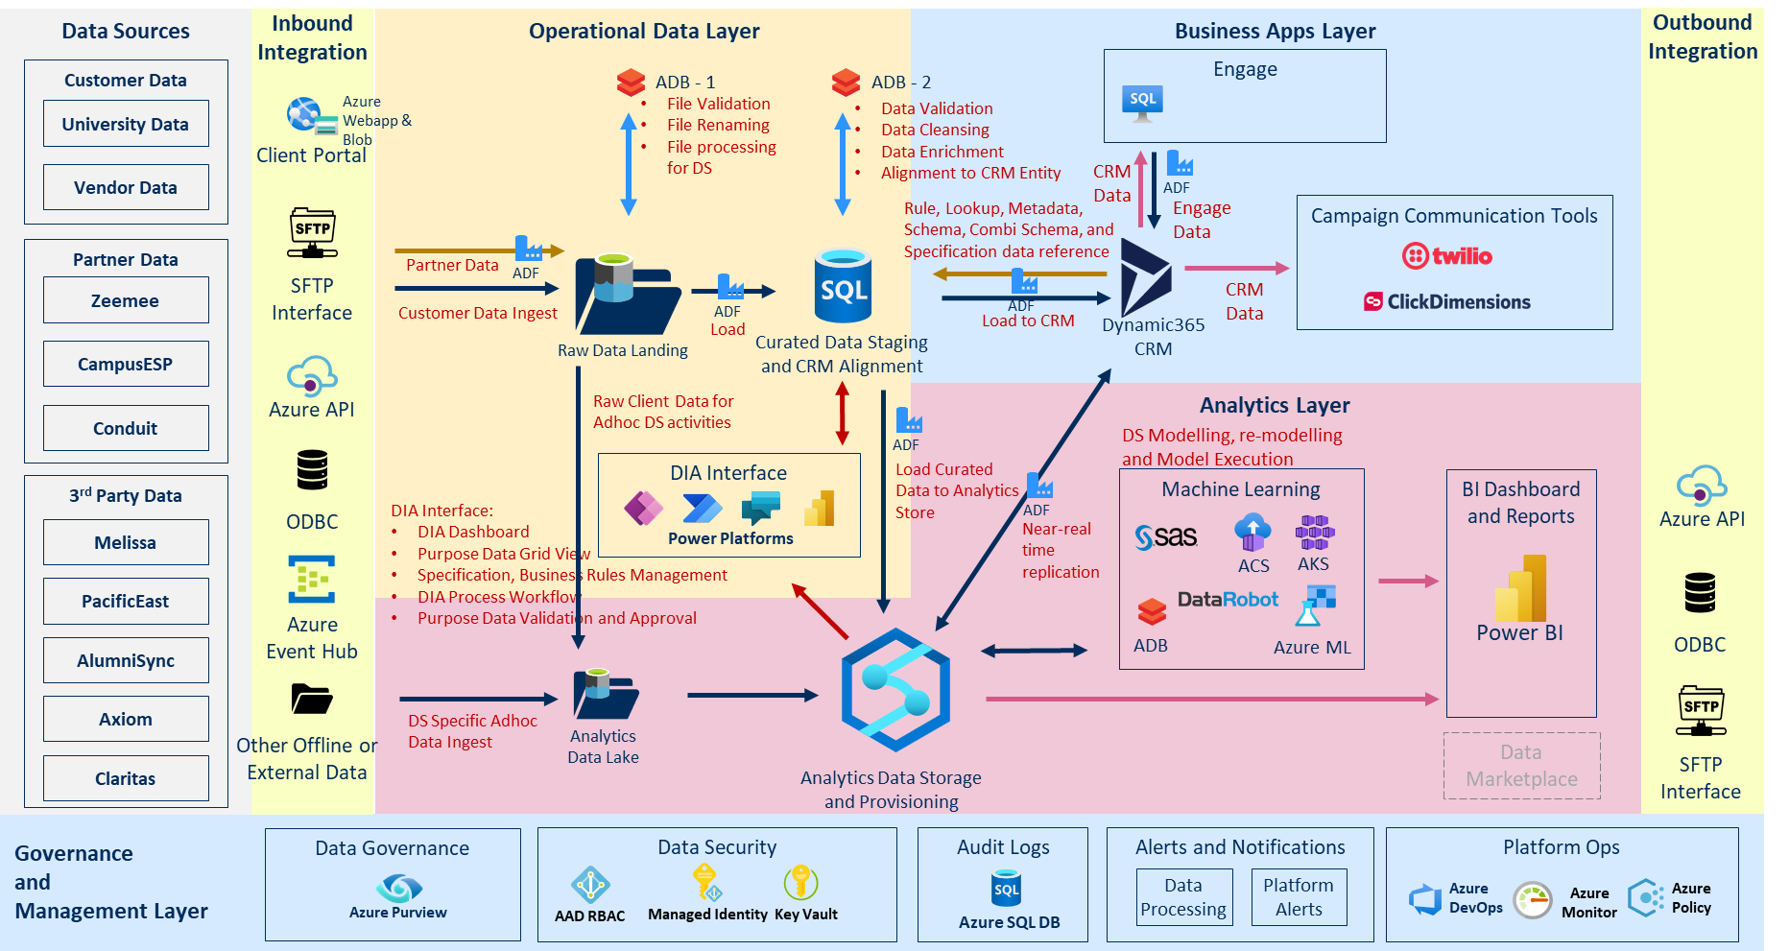
Solution Architecture for Next Gen Data Platform
Notes:
RNL

